Slide 1

Hospital Patient Record System

Slide 2
INTRODUCTION
Streamlining Patient Management with C
Efficient Data Handling
C Programming Foundation
Structured Record Keeping
The Hospital Patient Record System is designed to meticulously manage patient details, ensuring accuracy and accessibility.
This robust system is implemented using C programming, leveraging its efficiency for data storage and retrieval.
Records are stored in a highly structured format, significantly reducing the inconsistencies and errors associated with manual record keeping.

Slide 3

Core Patient Information
Patient ID
1
Unique identification number for each patient.
Name
2
Full name of the patient for accurate record association.
Age
3
Patient's current age, crucial for medical assessments.
Gender
4
Gender information, vital for demographic analysis and medical considerations.

Slide 4

Comprehensive Medical Data
Doctor & Specialization
Records the treating doctor's name and their specific medical specialization.
Diagnosis Details
Detailed information regarding the patient's diagnosis and medical condition.
Treatment Information
Outlines the prescribed treatment plan and any ongoing medical procedures.
Patient Medical History
A complete overview of past illnesses, surgeries, and significant health events.

Slide 5
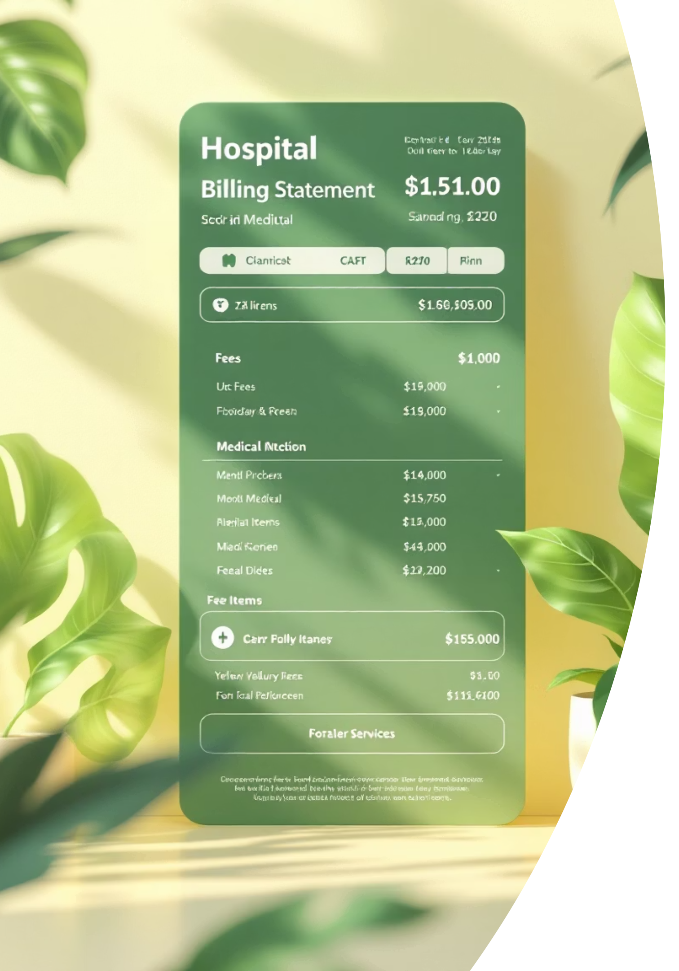
Financial and Administrative Records
Consultation Fee
Records the charges for doctor's consultation services.
Medicine Charges
Details costs associated with prescribed medications.
Total Bill Calculation
Automates the summation of all services and medications for billing.
Discharge Summary
A comprehensive report provided to the patient upon leaving the hospital.

Slide 6

C Programming Fundamentals: Strings
Strings are fundamental in C for handling names and textual data. In our Hospital Patient Record System, they are crucial for storing important identifiers and descriptive information.
Used extensively for patient names, doctor names, and other descriptive fields.
Implemented efficiently using character arrays, a core feature of C.
Example: char name[20]; allocates space for a patient's name up to 19 characters plus a null terminator.

Slide 7

C Programming Fundamentals: Arrays
Arrays in C are indispensable for managing multiple patient records and handling collections of similar data types within the system.
Enable the storage of numerous patient ages, IDs, and bill amounts in a structured manner.
Facilitate the efficient management and processing of data for a large number of patients simultaneously.
Example: int age[50]; can store the ages of up to 50 patients.

Slide 8

C Programming Fundamentals: Loops
Loops are essential control structures in C that allow for the efficient handling of repeated operations, streamlining data entry and display within the patient record system.
Used to systematically enter details for multiple patients, reducing repetitive coding.
A for loop is ideal for iterating through and displaying all stored patient records.
A while loop provides dynamic menu options, allowing users to interact with the system effectively.

Slide 9
FILE HANDLING FUNCTIONS :
fopen() – Opening a File
The fopen() function establishes a link between the program and the physical file on the disk.
Syntax:
FILE *fp = fopen("filename.txt", "mode");
Start
↓
Give file name & mode
↓
fopen()
↓
File opened?
↓
Yes → Use file
No → Error
↓
End
fopen_s.c
|
v
safe_lib.h
/ | | | \
v v v v v
safe_config.h safe_lib_errno.h safe_types.h safe_compile.h time.h
| | | |
v v v v
errno.h errno.h stdio.h sys/types.h

Slide 10
fwrite() – Writing Data
The fwrite() function is used for binary output. It writes a block of memory to the file.
Syntax:
fwrite(ptr, size, nmemb, fp);
Start
↓
Open file
↓
fwrite(data)
↓
Data written
↓
Close file
↓
End

Slide 11
fclose() – Closing the File
Closing a file is a critical step to prevent data loss and free up system resources.
Syntax:
fclose(fp);
Start
↓
fclose(file)
↓
File closed
↓
End

Slide 12


Conclusion: A Simple Yet Effective System
C Language Efficiency
The C language proves highly effective for managing hospital data, offering both speed and control.
Simplified Record Handling
The strategic use of strings, arrays, and loops significantly simplifies complex record management tasks.
Simple & Effective
The system design is straightforward yet highly functional, ensuring ease of use and reliability.
Scalability & Learning
Ideal for small hospitals or as an educational tool for aspiring programmers.

Slide 13
Presented By
P SRAVANI-25A31A04F1
P ABHINAVYA-25A31A04F2
K VENKATA SUDHEER-25A31A04I2
M ASHISH-25A31A04I3
THANK YOU

